Slide 1
Heckling/Trash talk with cell biology
Weak. Do you have a mutation in your electron transport chain?
That’s weaker than a transgenic mouse without myosin.
Oh yeah? Your mother’s mitochondrial DNA!
Hope you don’t pass on those Loser genes.
I guess your alleles are capital L, capital L, homozygous Loser.
You lost so badly I modified your histones and your kids will feel it.
You lost so badly I methylated your DNA and your kids will feel it.
I can tell it wouldn’t take long to sequence YOUR genome.
I think that your synapses are a few vesicles short.
The synapses were there, but the vesicles weren’t docked, if you know what I’m saying.
Your brain puts the dope in dopamine.
You folded like a globular protein.
You collapsed like an unstable microtubule.
Get up, that was no foul. That’s more actin’ than in a growth cone.
Your argument has more holes in it is than a membrane with open ion channels!
Insert your own heckling to ‘aid’ with studying

Slide 2
Announcements
Please complete online course evaluations!
Review questions and assessment items for final exam are available on Blackboard
Final Exam (alternative)– Saturday, 12/10, from 4-6 pm - Lilly 1-105
Final Exam (scheduled)– Saturday, 12/17, from 3:30-5:30 pm - WTHR 200

Slide 3
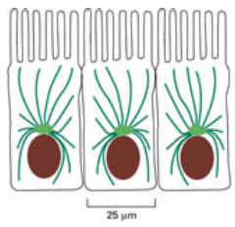
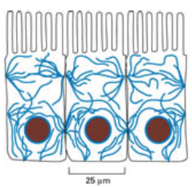
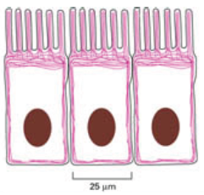
Three Major Types of Cytoskeleton
Microtubules (MTs)
Hollow, rigid cylindrical tubes with a ~25 nm outer diameter
4 nm thickness walls made of α and β tubulin
Lengths similar to the cell diameter
Best characterized in kinesin transport and cell division.
Intermediate filaments (IFs)
Strong, solid, ropelike fibers composed of a variety of related proteins
10-12 nm in diameter
Found throughout the cell
Made of members of a large, heterogenous family
Composition varies based on subcellular location, i.e. keratin in epithelial cells.
Microfilaments (MFs)
Solid, thinner structures
~8 nm diameter
Made of actin monomers
Can form branched 2D or 3D networks
Found predominantly in the cortex, below the plasma membrane.
http://homepage.smc.edu/wissmann_paul/anatomy2textbook/1cytoskeleton.html

Slide 4
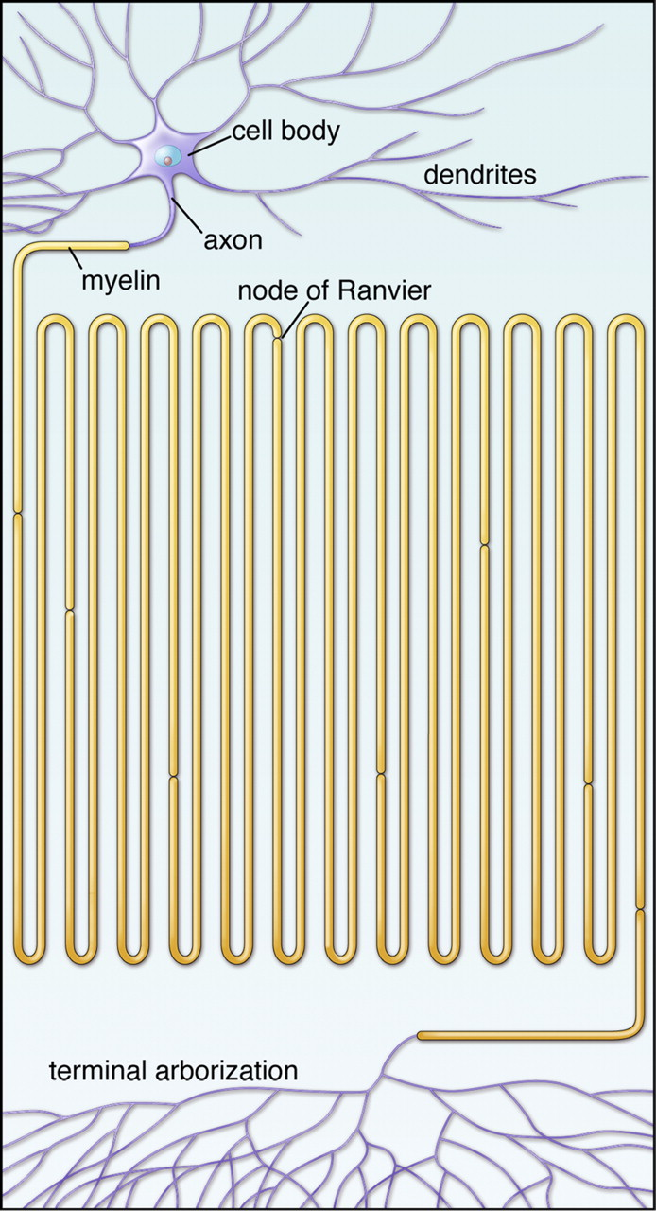

Schematic representation of an adult vertebrate neuron whose axon corresponds to a length of ∼1 cm.
Antonio Giuditta et al. Physiol Rev 2008;88:515-555
©2008 by American Physiological Society
Notes:
Schematic representation of an adult vertebrate neuron whose axon corresponds to a length of ∼1 cm. Several neurons have axons longer than 1 m and may form thousands of synapses in their terminal arborization. [Modified from D'Angelo and Peres (64).]

Slide 5
Clicker question: Which of the following is correct?
A. Microtubule trimers consist of alpha-GTP, beta-GTP and gamma GDP/GTP
B. Microtubule dimers consist of alpha-GTP, beta-GDP/GTP
C. Microtubule tetramers consist of alpha-GDP, beta-GDP and alpha-GTP, beta-GTP
D. Microtubule dimers consist of alpha-GDP, beta-GDP/GTP
Notes:
Answer is B

Slide 6
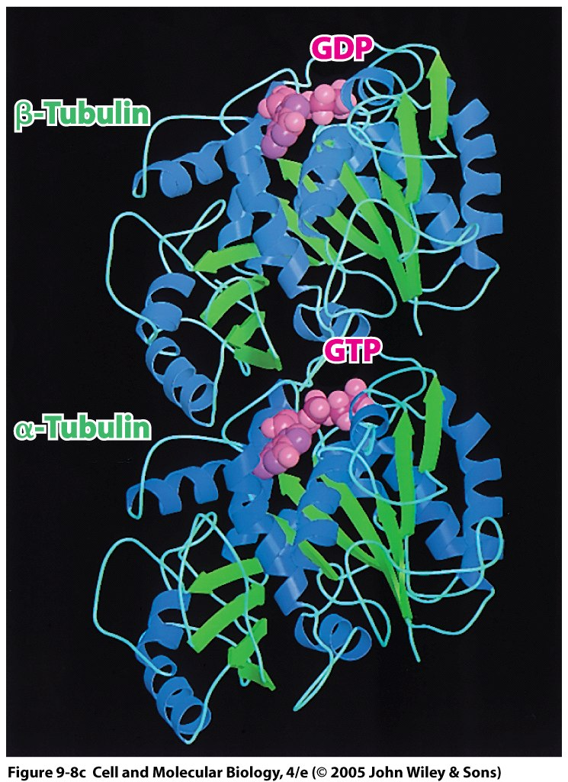
Microtubule subunit structure
The alpha and beta tubulin subunits form heterodimers that are the basic components of microtubules
Tubulins polymerize in a GTP hydrolysis-dependent mechanism.
Subunits are complementary and can be distinguished by GDP or GTP
Strong structural similarity (40% protein sequence identity)
Beta-subunit has a bound GDP, which is exchanged for GTP during microtubule assembly
Alpha-subunit has a bound GTP that is nonexchangeable
Notes:
Complementary subunits: alpha with nonexchangeable GTP bound and beta with GDP bound
Not until the dimer incorporates into MTs that GTP-beta tubulin is hydrolyzed leaving the beta-tubulin with a bound GDP
- They possess structural similarity (40% protein sequence identity)
- Together these subunits make a heterodimer, the basic component of microtubules.

Slide 7
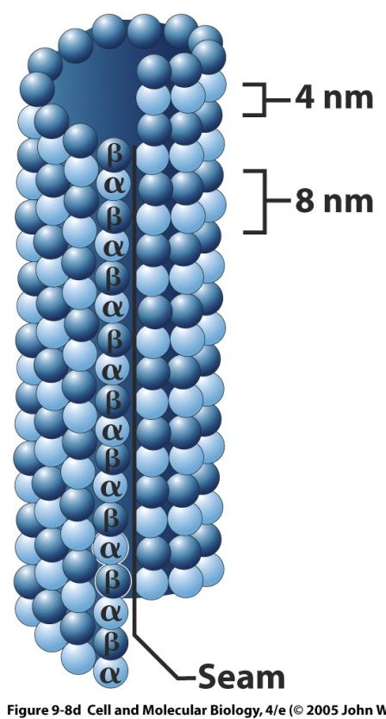

Microtubule protofilament structure
+ end
For alpha subunit, nonexchangeable GTP bound. For beta, switches between GDP/GTP bound.
A chain of alpha/beta dimers → protofilament
Generally 13 protofilaments/microtubule
A seam is formed where alpha and beta subunits are directly adjacent to each other
Microtubule unstable when seam closes
Asymmetric: alpha-tubulin at one end & beta-tubulin at the other end → polarity
Plus end - fast-growing (beta-tubulins on tip); minus end - slow-growing (alpha-tubulins on tip)
Polarity important for growth and transport
Axon: all plus-end distal
Dendrite: plus and minus-end distal (by minus-end distal, we mean minus-end pointing away from nucleus)
- end
Notes:
Each protofilament is assembled from dimeric building blocks (one a-tubulin & one b-tubulin globular subunit; a heterodimer); the tubulin dimers are organized in linear array along length of protofilament
1. The two types of tubulin subunits have similar 3D structure & fit tightly together
2. Protofilaments are asymmetric (a-tubulin at one end, b-tubulin at other); each assembly unit has 2 nonidentical components (heterodimer)
3. All protofilaments of microtubule have same polarity; thus so does full tubule (plus- & minus-end)
4. Plus end - fast-growing (b-tubulins on tip); minus end - slow-growing (a-tubulins on tip)
5. Structural polarity of microtubules is important factor in growth of these structures & their ability to participate in directed mechanical activities
(b) Electron micrograph of a cross-section through a microtubule of a Juniperus root tip cell → 13 subunits around the wall of the tubule.

Slide 8
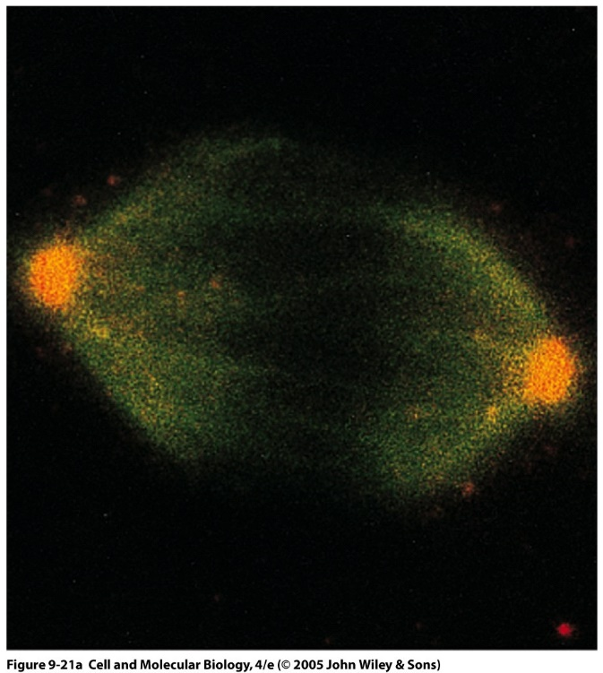
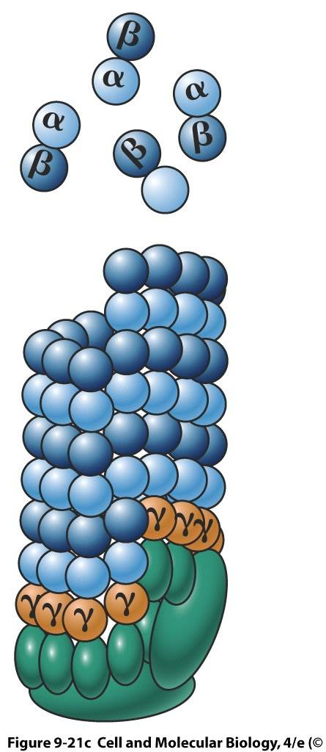
Microtubule assembly -- nucleation
Gamma-tubulin constitutes only a small proportion of total tubulin
Gamma-subunits ➔ “ring complexes” of centrioles in MTOC, which are the same diameter as microtubules
Alpha-beta heterodimers (beta on plus-end tip) can then bind to gamma starter subunits mounted on ring complexes
Notes:
Left: Gamma-tubulin (red fluorescence) colocalizes with beta-tubulin (green fluorescence) → orange fluorescence in microtubule organizing centers (MTOCs)
Right: assembly of MTs from alpha/beta-tubulin dimers (nucleation, elongation)
minus end of MTs associated with MTOC, while plus end grows, receiving subunits
→ gamma-tubulin rings may form template on top of which alpha/beta tublin dimers can assemble.

Slide 9
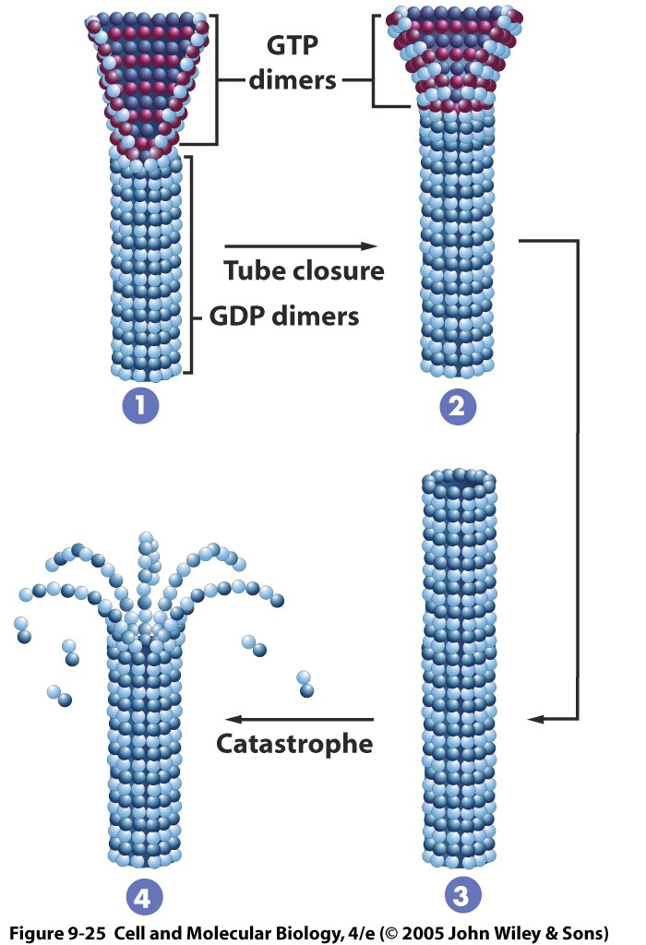
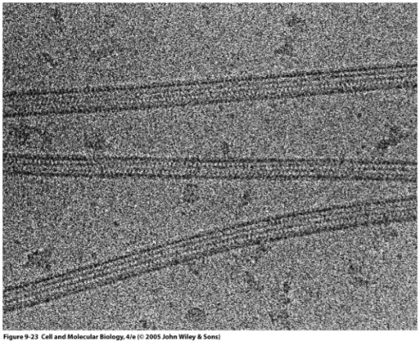
Microtubule assembly -- elongation
GTP is bound to beta subunit of a soluble heterodimer
GTP is hydrolyzed some time after dimer attaches to growing chain. GDP remains bound
Plus-end of growing microtubule widens as rate of growth exceeds rate of GTP hydrolysis
Addition of GTP-tubulin to plus-end is favorable
Full conversion to GDP and closure of tip
Mechanical strain on protofilament
“Catastrophic shrinkage” or depolymerization
http://www.youtube.com/watch?v=9ICqcZ99qGk (microtubule dyn.)
Notes:
9-25: dynamic instability – structural cap model
GTP is bound to beta subunit of a soluble heterodimer
GTP is hydrolyzed some time after dimer attaches to growing chain. GDP remains bound
Plus-end of growing microtubule widens as rate of growth exceeds GTP hydrolysis
Addition of GTP-tubulin to plus-end is favorable
Full conversion to GDP and closure of tip → mechanical strain on protofilament → “catastrophic shrinkage” or depolymerization
9-23: microtubule assembly in test tube:
Assembly of 3 MTs from purified tubulin; however, no gamma-tubulin ring complex or MAPs

Slide 10
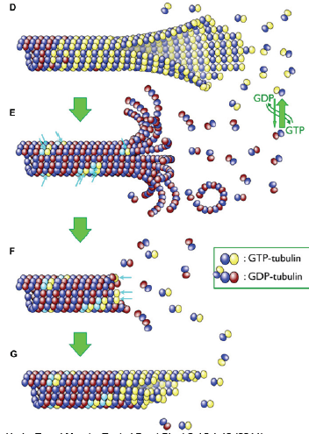
Microtubule depolymerization – Microtubule Catastrophes
GTP caps stop depolymerization to rescue the microtubule.
GTP-bound dimers restore polymerization.
Tubulin binding proteins regulate dynamics. Stabilizers bridge multiple pairs of dimers. Destabilizers promote catastrophes.
Gardner, M.K. et al Curr Opin Cell Biol 25, 14-22 (2013); Horio, T. and Murata, T. et al Front Plant Sci 5 1-10 (2014)

Slide 11
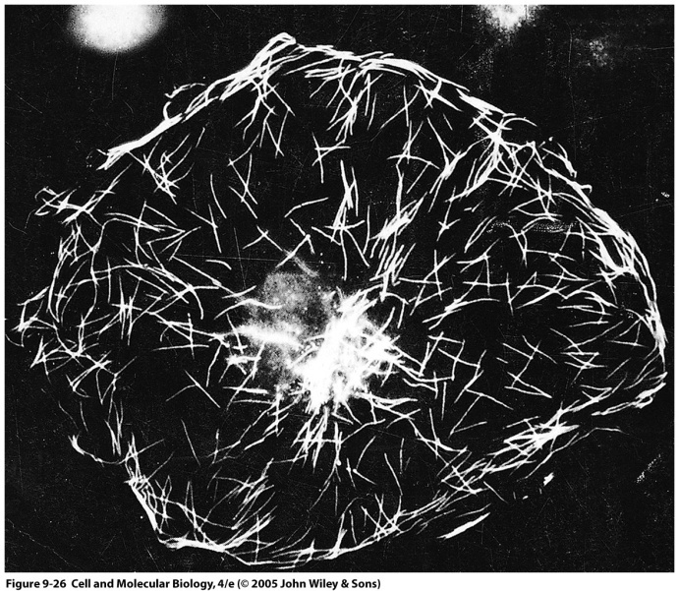
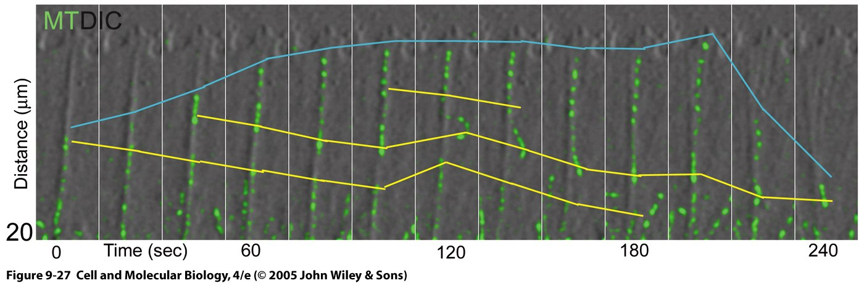
In vivo microtubule dynamics: Dynamic Instability
Left: Biotin-labeled tubulin (after one minute in growing fibroblast). Tubulin incorporated widely at growing ends.
Right: Tracking fluorescent speckles of an individual microtubule labeled with fluorescent tubulin at low concentration
Gradual growth of microtubules (0-200 sec)
Rapid depolymerization in last frames (200-240 sec)
Dynamic instability: coexistence of growing and shrinking microtubules and rapid length change of individual microtubules
Vedio: https://www.youtube.com/watch?v=21P100yiEN8
Notes:
9-26: fluorescent anti-biotin antibodies reveal biotin-labeled tubulin one minute post-injection of tubulin in a growing fibroblast → tubulin incorporated widely at growing ends.
9-27: series of photographs showing the change in length of a single MT in the growth cone of a neuron (after injection with fluorescently labeled tubulin at low concentration to produce speckles)
Depolymerization and replacement occurs more quickly than growth in many conditions unless stabilized by microtubule-associated proteins (MAPs) (e.g. axons)
Organelle microtubules are much more stable than cytoskeletal ones

Slide 12
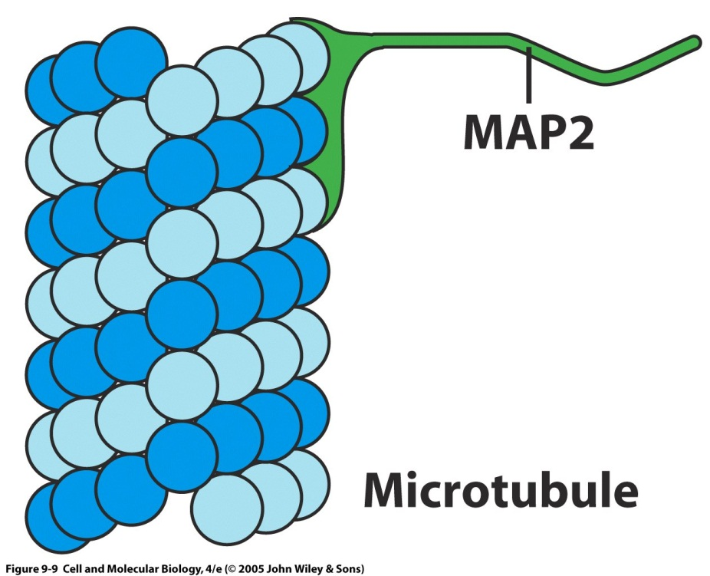
Microtubule associated proteins (MAPs) stabilize microtubules to prevent or delay instability
Regulate microtubule dynamics
Mostly in neural tissue
(MAP4 in non-neuronal cells)
One microtubule associating domain and one filament
Usually promote assembly and stability
Association with microtubules controlled by phosphorylation
Notes:
12

Slide 13
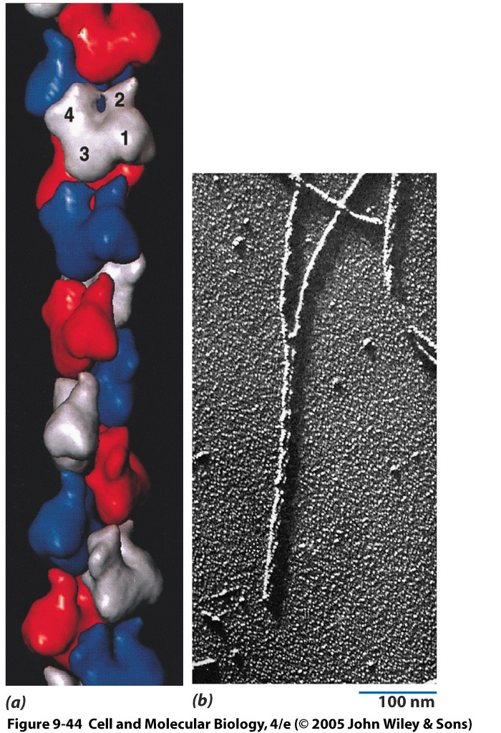
Actin Microfilaments
Actin monomer = Globular actin = G-actin
Microfilament = actin filament = F-actin
~8 nm in diameter
Globular subunits: G-actin monomers
All monomers point in the same direction, twist around each other and form double helices
Wide range of organizational patterns
Roles:
Muscle contractility
Phagocytosis
Organelle movement
Growth cones (axons)
Wound healing
Contractile ring (cytokinesis)
Actin subunits:
Polarity
Pointed in same direction → microfilament polarity
Notes:
9-44: a) model of microfilament – subunits represented in three colors, subdomains numbered 1-4, and ATP-binding cleft visible
b) Electron micrograph showing double helices of a replica of an actin filament
they are also involved in intracellular motile processes (vesicle/organelle movement, phagocytosis, cytokinesis)
A. Neural crest cells in vertebrate embryo leave developing nervous system & migrate across entire width of embryo, forming diverse products: skin pigment cells, teeth, cartilage of jaws
B. Legions of white blood cells patrol body tissues searching for debris & microorganisms
C. Certain parts of cells can be motile
1. Broad projections of epithelial cells at wound edge act as motile devices that pull the cell sheet over the damaged area, sealing the wound
2. Leading edge of growing axon sends out microscopic processes that survey the substratum & guide the cell toward a synaptic target
D. Plant cells seem to rely mostly on MFs, rather than MTs for long-distance transport of cytoplasmic vesicles & organelles; bias for MF-based motility reflects the rather restricted MT distribution in many plant cells
II. MFs (F-actin) - ~8 nm diameter; made of globular actin subunits (G-actin) – highly conserved (88% sequence identity between yeast and mammalian actin); found in most animal cells, also higher plants; MF, actin filament, & F-actin are synonyms, but F-actin is often used for those formed in vitro
A. In presence of ATP, actin monomers (G-actin) polymerize to form stiff filament made of 2 strands of actin molecules wound around each other in double helix
1. Each actin subunit has polarity & all actin filament subunits are pointed in same direction, so entire MF has polarity
B. Depending on cell type & activity in which it is engaged, MFs can be organized into highly ordered arrays, loose ill-defined networks, or tightly anchored bundles

Slide 14
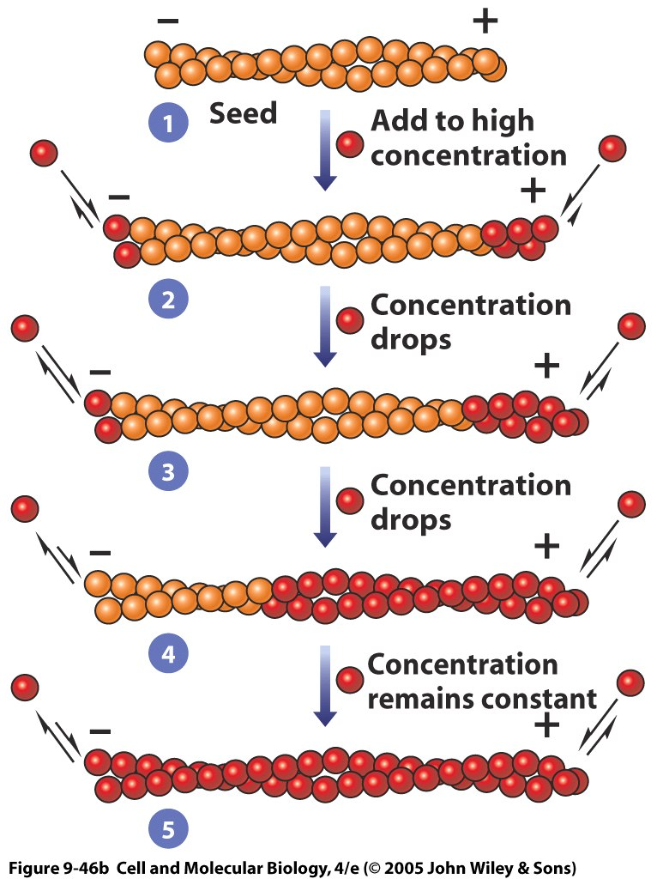
Actin filament assembly and disassembly
Actin monomer binds ATP molecule
Actin is an ATPase (like tubulin is a GTPase)
After monomer incorporates into growing actin filament, ATP is hydrolyzed to ADP
MFs are incubated in vitro with high concentration of labeled actin-ATP subunits
Plus-end incorporates monomers ~10x more quickly than the minus-end
Actin-ATP concentration drops until net addition of monomers is on plus-end
Minus-end favors continued depolymerization, as monomers ‘treadmill’
Reactions reach steady state and length of filament stays constant
Actin filaments exhibit dynamic instability similar to MTs
Vedio: https://www.youtube.com/watch?v=VVgXDW_8O4U

Slide 15
Clicker question: How will increasing [ATP] affect microtubules?
It will increase microtubule stability
It will increase microtubule length
It will decrease microtubule stability
It will decrease microtubule length
It will have no effect
Notes:
Answer is E

Slide 16
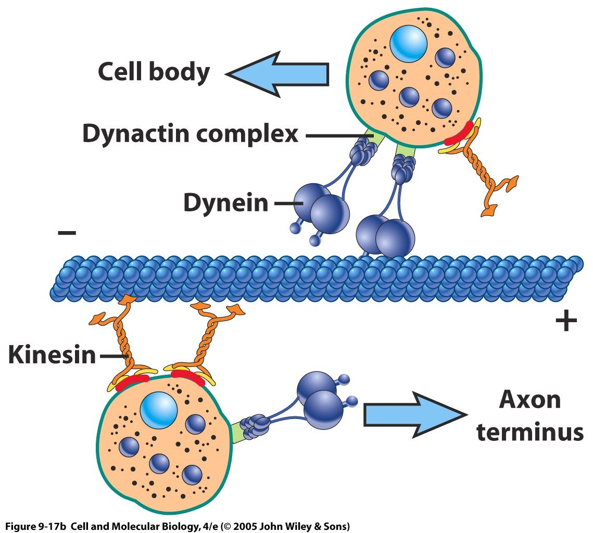
Molecular Motors for Microtubules

Slide 17
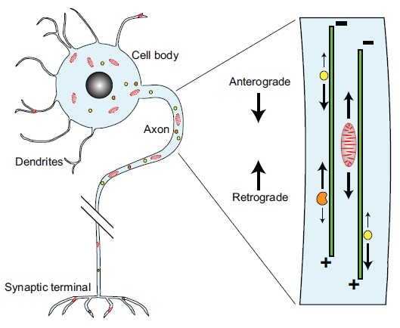
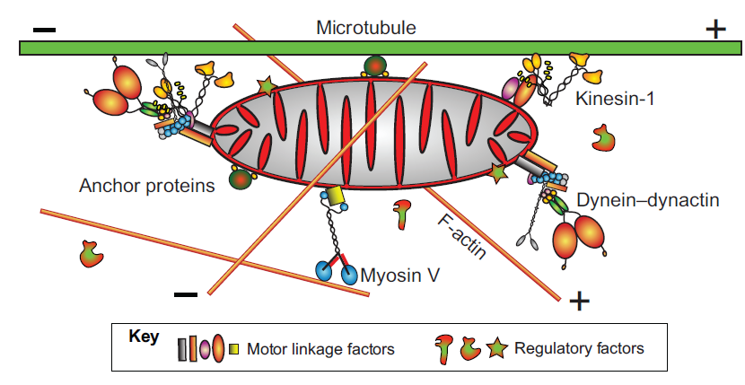
Example: Axonal transport
Anterograde: Deliver newly synthesized organelles or materials into the axon and toward the terminal
Retrograde: Return aged materials back to the cell body for degradation and recycling.
Motor proteins:
Kinesin (anterograde)
Dynein (retrograde)
Myosin
(most of them move towards plus end except myosin VI)
Microtubule
Actin
W.M. Saxton and P.J. Hollenbeck (2012)

Slide 18
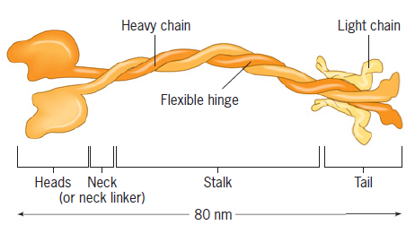
Kinesin
A pair of globular heads that bind a microtubule and act as ATP-hydrolyzing, force-generating “engines.”
The motor portions of all KRPs have related amino acid sequences.
--- similar role in moving along microtubules.
Tails of KRPs have diverse sequences.
---variety of cargoes
A plus-end directed microtubular motor.

Slide 19
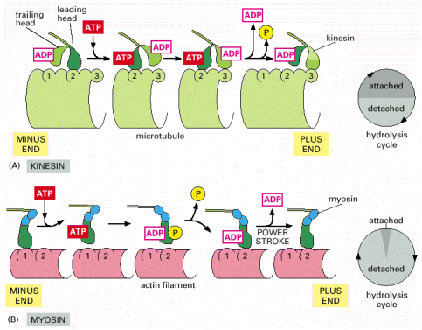
Kinesin Mechanochemical Cycle
At the start of the cycle, the leading head (dark green) is bound to the microtubule. The trailing head (light green) is detached and bound to ADP.
Binding of ATP to the front head causes a major conformational change. The rear head is thrown forward, past the binding site of the attached head, to another binding site further toward the plus end of the MT.
Release of ADP from the second head (now in the front) and hydrolysis of ATP on the first head (now in the rear) brings the dimer back to the original state.
The two heads have switched their relative positions, and the motor protein has moved one dimer step along the microtubule protofilament.
Alberts et al.
Kinesin walking movie!
https://www.youtube.com/watch?v=y-uuk4Pr2i8
Notes:
Figure 16-59. Comparison of the mechanochemical cycles of kinesin and myosin II. The shading in the two circles representing the hydrolysis cycle indicates the proportion of the cycle spent in attached and detached states for each motor protein. (A) Summary of the coupling between ATP hydrolysis and conformational changes for kinesin. At the start of the cycle, one of the two kinesin heads, the front or leading head (dark green) is bound to the microtubule, with the rear or trailing head (light green) detached. Binding of ATP to the front head causes the rear head to be thrown forward, past the binding site of the attached head, to another binding site further toward the plus end of the microtubule. Release of ADP from the second head (now in the front) and hydrolysis of ATP on the first head (now in the rear) brings the dimer back to the original state, but the two heads have switched their relative positions, and the motor protein has moved one step along the microtubule protofilament. In this cycle, each head spends about 50% of its time attached to the microtubule and 50% of its time detached. (B) Summary of the coupling between ATP hydrolysis and conformational changes for myosin II. Myosin begins its cycle tightly bound to the actin filament, with no associated nucleotide, the so-called “rigor” state. ATP binding releases the head from the filament. ATP hydrolysis occurs while the myosin head is detached from the filament, causing the head to assume a cocked conformation, although both ADP and inorganic phosphate remain tightly bound to the head. When the head rebinds to the filament, the release of phosphate, followed by the release of ADP, trigger the power stroke that moves the filament relative to the motor protein. ATP binding releases the head to allow the cycle to begin again. In the myosin cycle, the head remains bound to the actin filament for only about 5% of the entire cycle time, allowing many myosins to work together to move a single actin filament.
2 heads of kinesin behave in coordinated manner, so that they are always present at different stages in their chemical & mechanical cycles at a given time
When one head binds to MT, the interaction induces a conformational change in adjacent neck region of motor protein that causes the other head to swing forward toward its binding site on protofilament
Force generated by head catalytic activity leads to large-scale swinging movement of neck
A kinesin molecule walks along a MT, hydrolyzing one ATP with each step

Slide 20
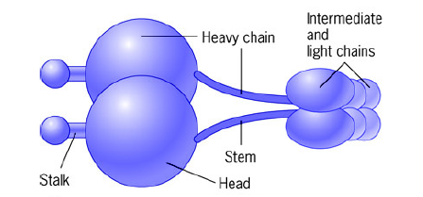
Cytoplasmic Dynein
a huge protein (molecular mass of approximately 1.5 million daltons)
Heads act as force-generating engines.
Each stalk contains the all-important microtubule-binding site at its tip.
A minus-end directed microtubular motor.

Slide 21
Dynein Movement (Minus-End Directed)
Cytoplasmic dynein involved in positioning of spindle & chromosome movement during mitosis
Also a minus-end-directed microtubular motor for positioning & movement of vesicles & organelles through cytoplasm
In neurons, cytoplasmic dynein implicated in retrograde cytoplasmic movement (towards cell body from dendrites)
Cytoplasmic dynein does not interact directly with membrane-bound cargo, but requires an intervening multisubunit adaptor, dynactin
Dynein struts like a drunken sailor…
Notes:
Body of evidence suggests 2 roles of cytoplasmic dynein
A. Force generating agent in positioning of spindle & chromosome movement during mitosis
B. "-"-end-directed microtubular motor for Golgi complex positioning & movement of vesicles & organelles through cytoplasm
1. In nerve cells, cytoplasmic dynein implicated in retrograde cytoplasmic organelle movement (toward cell body & cell center) & anterograde movement of MTs
2. In fibroblasts & other nonneural cells, it may transport membranous organelles (endosomes, lysosomes, ER-derived vesicles heading toward Golgi complex) from peripheral locations toward cell center
III. Cytoplasmic dynein does not interact directly with membrane-bounded cargo, but requires an intervening multisubunit adaptor, dynactin, that may also regulate dynein activity & help bind motor protein to MT

Slide 22
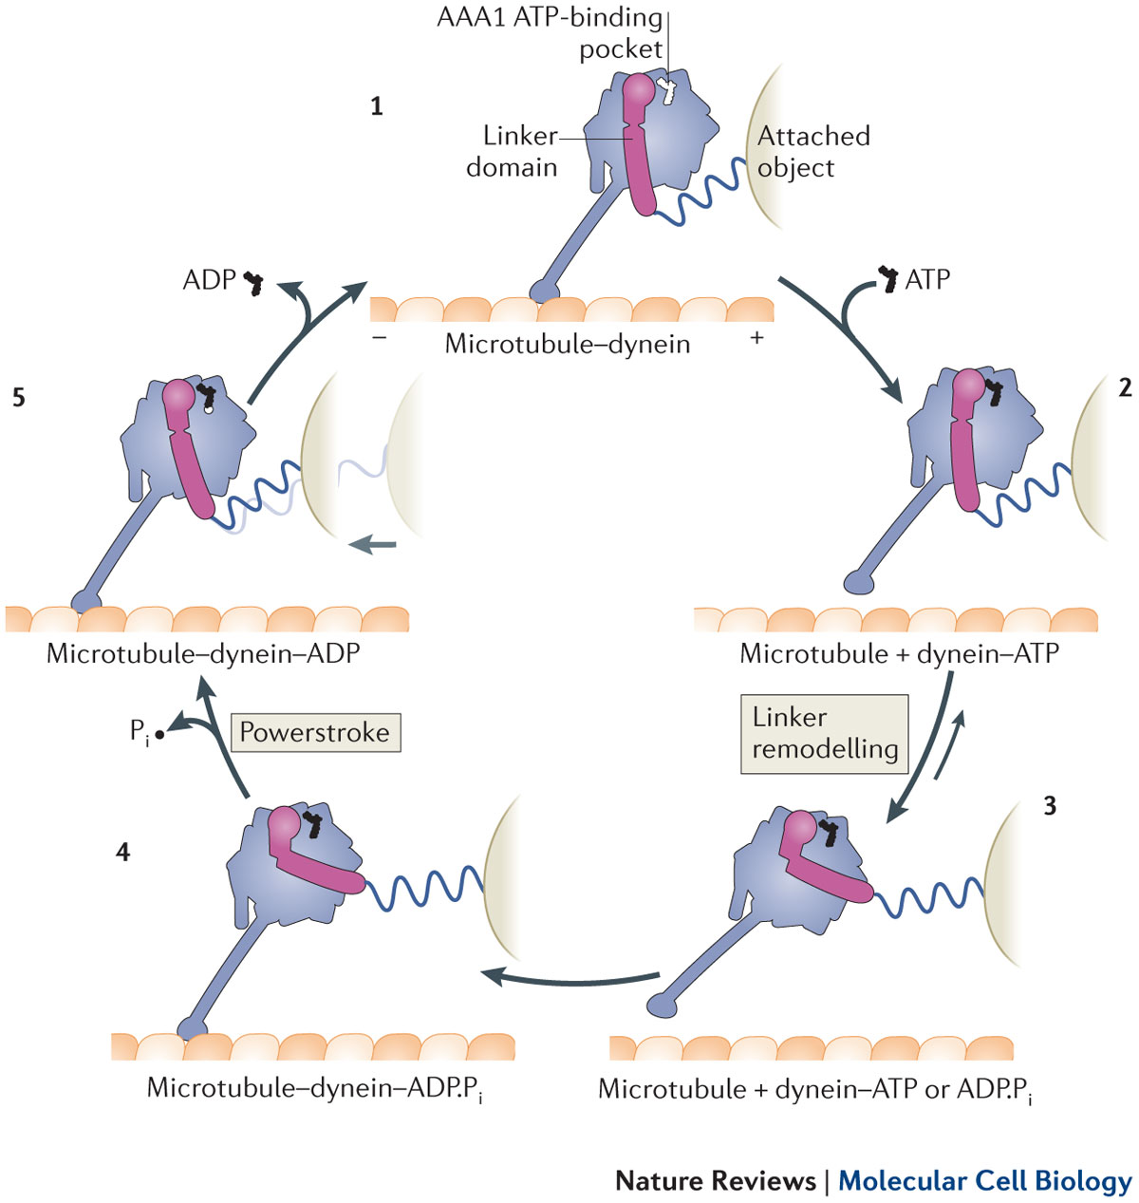
Dynein Mechanochemical Cycle
The dynein motor domain is tightly bound to the microtubule .
ATP binding induces rapid dissociation from the microtubule
Linker remodeling (step 3) extends the dynein arm forward along the microtubule.
After hydrolysis of ATP to ADP and inorganic phosphate (Pi), the motor domain engages a new binding site on the microtubule, initially via a weak interaction (step 4 in fig.). Strong binding to the microtubule accelerates the release of Pi, inducing the linker to revert to its straight form. This transition represents the powerstroke: the main step in which force (indicated by the light grey arrow) is transmitted to the attached object.
Finally, ADP is released (step 5) and the cycle restarts.
Figure 3 | Model of the mechanochemical cycle of a cytoplasmic dynein motor domain.
https://www.youtube.com/watch?v=obdWy-7gMrw
Notes:
Anthony J. Roberts,et al. Nature Reviews Molecular Cell Biology 14, 713–726 (2013)

Slide 23
Kinesin vs myosin motors
Notes:
Figure 16-59. Comparison of the mechanochemical cycles of kinesin and myosin II. The shading in the two circles representing the hydrolysis cycle indicates the proportion of the cycle spent in attached and detached states for each motor protein. (A) Summary of the coupling between ATP hydrolysis and conformational changes for kinesin. At the start of the cycle, one of the two kinesin heads, the front or leading head (dark green) is bound to the microtubule, with the rear or trailing head (light green) detached. Binding of ATP to the front head causes the rear head to be thrown forward, past the binding site of the attached head, to another binding site further toward the plus end of the microtubule. Release of ADP from the second head (now in the front) and hydrolysis of ATP on the first head (now in the rear) brings the dimer back to the original state, but the two heads have switched their relative positions, and the motor protein has moved one step along the microtubule protofilament. In this cycle, each head spends about 50% of its time attached to the microtubule and 50% of its time detached. (B) Summary of the coupling between ATP hydrolysis and conformational changes for myosin II. Myosin begins its cycle tightly bound to the actin filament, with no associated nucleotide, the so-called “rigor” state. ATP binding releases the head from the filament. ATP hydrolysis occurs while the myosin head is detached from the filament, causing the head to assume a cocked conformation, although both ADP and inorganic phosphate remain tightly bound to the head. When the head rebinds to the filament, the release of phosphate, followed by the release of ADP, trigger the power stroke that moves the filament relative to the motor protein. ATP binding releases the head to allow the cycle to begin again. In the myosin cycle, the head remains bound to the actin filament for only about 5% of the entire cycle time, allowing many myosins to work together to move a single actin filament.

Slide 24

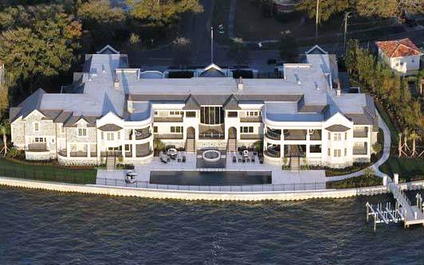


If you imagine a house whose shape was determined by your understanding of cells, what would it look like?
Notes:
http://www.eurweb.com/2011/02/photos-the-story-behind-derek-jeter%E2%80%99s-7-7-million-house/
http://bananajoke.com/stories/15-strangest-houses-around-the-world/
http://www.crystalinks.com/housesweird.html

Slide 25
Bio 230 Finals Jeopardy!
Old stuff | Membranes/Transport | Neurons | G protein coupled receptors | Receptor tyrosine kinases/insulin | Signal detection/more old stuff
100 | 100 | 100 | 100 | 100 | 100
200 | 200 | 200 | 200 | 200 | 200
300 | 300 | 300 | 300 | 300 | 300
400 | 400 | 400 | 400 | 400 | 400
500 | 500 | 500 | 500 | 500 | 500

Slide 26

The Finals Countdown
Biology 230
http://www.youtube.com/watch?v=9jK-NcRmVcw
Notes:
26
From 1986!

Slide 27
Course Learning Objectives
Describe cellular components, their functions, and their orientations in prokaryotic and eukaryotic cells.
Predict biochemical interactions based on energetics and/or 3-dimensional structure.
Given scenarios of biological regulation, predict outcomes of modifications to the scenarios.
Design cell biology experiments, including selection of appropriate techniques and formulation of a specific, testable scientific hypothesis.
Evaluate (gather, analyze and interpret) biological data in order to answer a biological question.
Use the concepts of homology, modularity and phylogenetics in order to determine relationships and predict functions of different genes or proteins or relationships between organisms.
Notes:
27

Slide 32
Draw a cell, take 2
Take 5 minutes and draw a human cell. Label specific organelles and include as much detail as you can.
We want to see what you have learned over the course of the semester…
Please include:
Name
PUID
Major
Year you last took a biology course

Slide 33
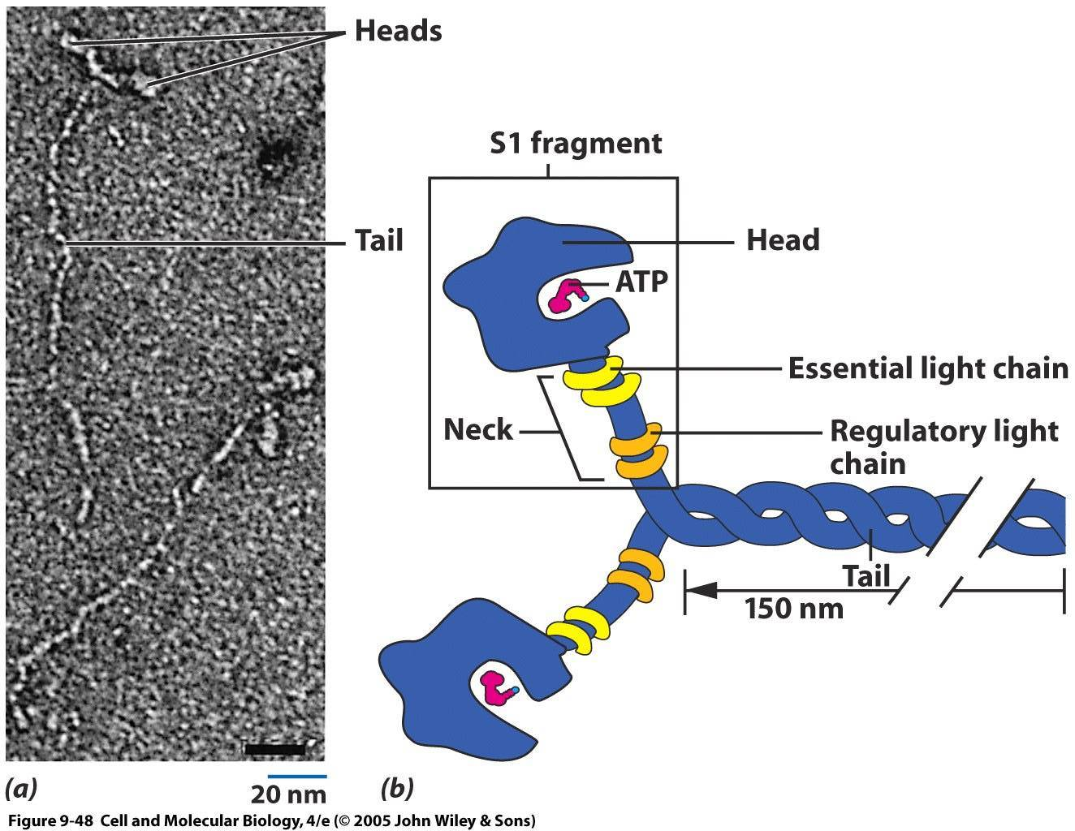
Motörheads and motörtails of myosin II: involved in muscle contraction and non-muscle motility
All myosins share characteristic motor (head) domain
Has a site that binds the actin filament & one that binds & hydrolyzes ATP to drive the myosin motor
Tail domains are highly divergent between myosins
Myosins also contain a variety of low molecular weight (light) chains
Humans have ~40 different myosins, each presumed to have its own specialized functions
Myosin II is the “conventional” myosin
Notes:
Structure of myosins – all of them share characteristic motor (head) domain, which has a site that binds the actin filament & one that binds & hydrolyzes ATP to drive the myosin motor
1. While the head domains of myosins are similar, the tail domains are highly divergent
2. Myosins also contain a variety of low molecular weight (light) chains
Humans have ~40 different myosins, each presumed to have its own specialized function(s); type II myosin molecules are best understood; several types of myosins may
Structure of myosin II molecules - 6 polypeptide chains (one pair of heavy chains, 2 pairs of light chains); organized in a way that produces a highly asymmetric protein with 3 sections
1. A pair of globular heads that contain the molecule’s catalytic site
2. A pair of necks, each consisting of a single, uninterrupted a-helix & 2 associated light chains
3. A single, long, rod-shaped tail formed by the intertwining of long, a-helical sections of the 2 heavy chains to form an a-helical coiled-coil

Slide 34
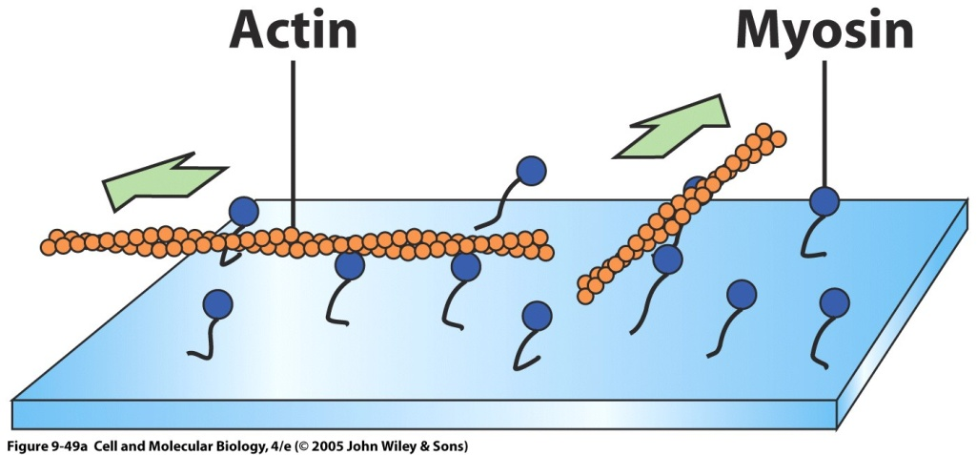
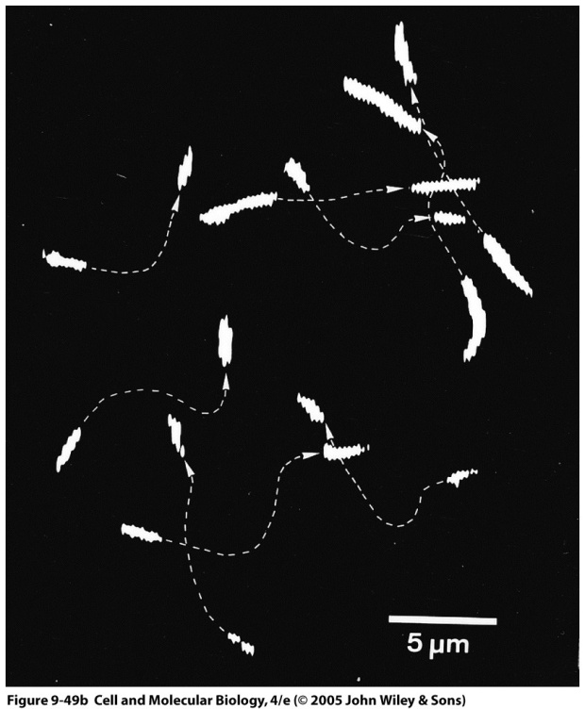
In vitro actin-myosin motility assay
Immobilize isolated myosin heads (S1 fragments) on glass cover slip and incubate with actin and ATP
Actin moves, so a single head domain has all of the machinery needed for motor activity
The fibrous tail portion of myosin plays a structural role, allowing the protein to form filaments
Notes:
Video of moving actin?

Slide 35
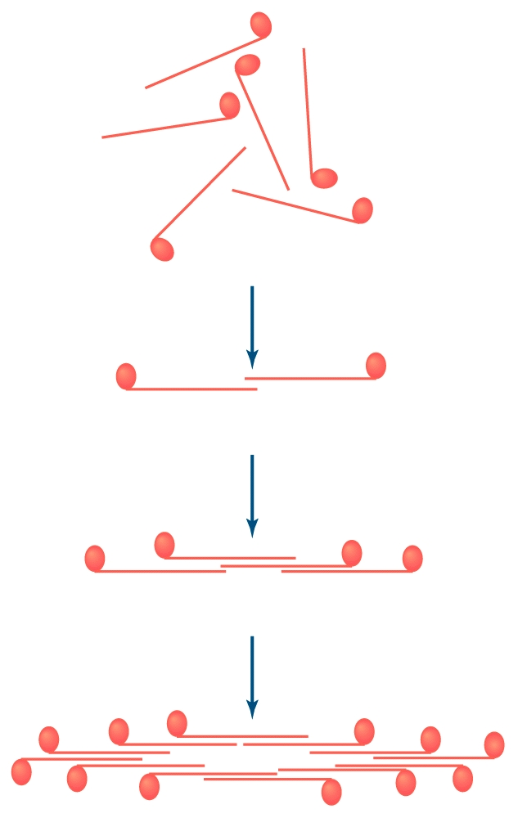
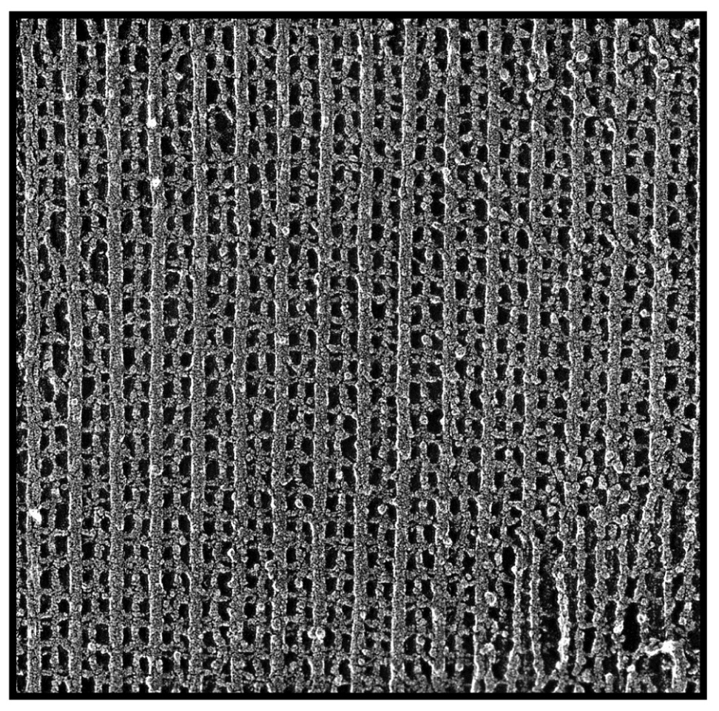
Myosin molecules spontaneously aggregate with tails
overlapping and heads pointing outward
Thick filaments with heads extending away
Thin filaments

Slide 36
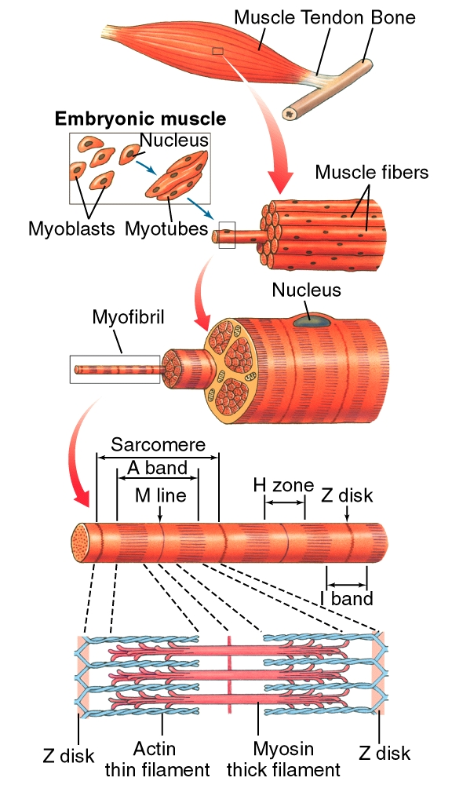
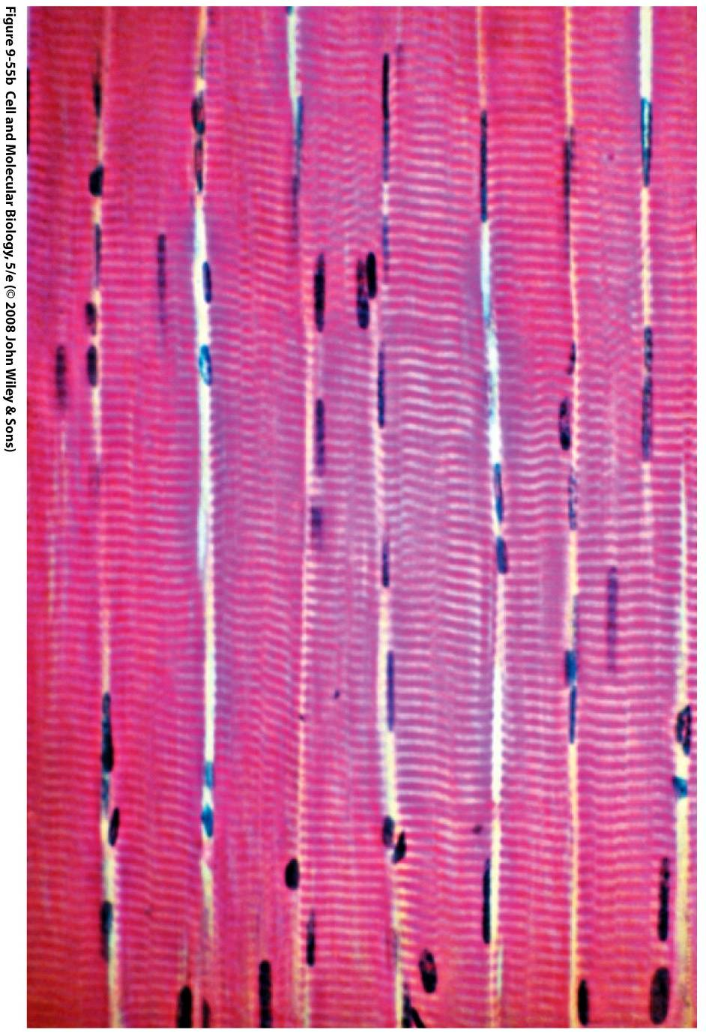
Organization of vertebrate skeletal muscle
Cylindrical cell; 10 - 100 µm thick; up to 40 mm long
Skeletal muscle cells are multinucleate (up to hundreds of nuclei),
Because of their properties, these cells are more appropriately called muscle fibers
Muscle fiber is a cable made up of hundreds of thinner, cylindrical strands (myofibrils); seen in longitudinal section
Each myofibril is made up of a repeating linear array of contractile units (sarcomeres)
Each sarcomere, in turn, has characteristic banding pattern that gives muscle fiber a striated appearance, hence the name of this muscle type
Notes:
II. Skeletal muscle cell structure - highly unorthodox; cylindrical cell; 10 - 100 µm thick; up to 40 mm long
A. Skeletal muscle cells are multinucleate (hundreds of nuclei), a result of embryonic fusion of large numbers of mononucleate myoblasts (premuscle cells); even myoblasts from distantly related animals fuse in culture
1. Because of their properties, these cells are more appropriately called muscle fibers
B. Skeletal muscle fiber cells may have the most orderly internal structure of any cell in body
1. Muscle fiber is a cable made up of hundreds of thinner, cylindrical strands (myofibrils); seen in longitudinal section
2. Each myofibril is made up of a repeating linear array of contractile units (sarcomeres)
3. Each sarcomere, in turn, has characteristic banding pattern that gives muscle fiber a striated appearance
4. Myofibrils separated by cytoplasm with intracellular membranes & mitochondria, lipid droplets, glycogen granules

Slide 37
Amazing movers!
Animal Top Speed Distance
Cheetah and leopard 70mph short bursts in pursuit
(80-90% fast twitch muscle, lots of fast glycolytic)
Pronghorn antelope 60mph for 2 miles
37mph for 27 miles
Lion 50mph short distances
Greyhounds 35-40mph
Hummingbird 55mph
(flight muscles exclusively FOG - mitochondrial specializations : cluster densely near capillaries and have more cristae!)
Arctic tern 22,000 miles in 20 wks
(flight muscles almost exclusively FOG)
http://www.newton.dep.anl.gov/natbltn/200-299/nb215.htm
Notes:
fast oxidative glycolytic (FOG)

Slide 38
FYI (Muscle Fiber Types)
 | Slow-oxidative | Fast-oxidative | Fast-glycolytic
mitochondria | many | many | few
capillaries | many | many | few
myoglobin content | high | high | low
myosin ATPase activity | low | high | high
contraction velocity | slow | fast | fast
rate of fatigue | slow | intermediate | fast
muscle fiber diameter | small | intermediate | large
innervating neuron size | small | intermediate | large
motor unit size | small | intermediate | large
http://courses.washington.edu/conj/bess/types/fibertypes.html

Slide 39
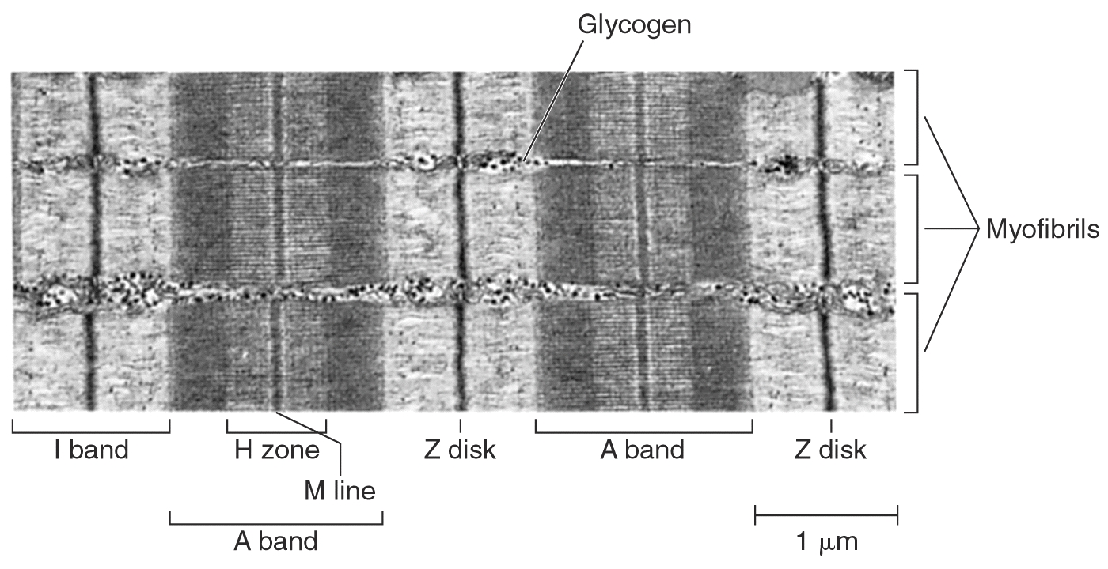
Myofibrils are organized into repeating serial units called
sarcomeres (the basic unit of contraction)
sarcomere
Z disk (line) - network of proteins
- thin filaments (actin) anchored here by α-actinin
- area between two Z discs is a sarcomere
M line – network of proteins
- thick filaments anchored here
Titin – filaments of huge elastin protein (largest known protein)
- runs from Z disk to M line
- anchored to M line and thick filaments
helps restore sarcomere
length after stretch or
contraction

Slide 40
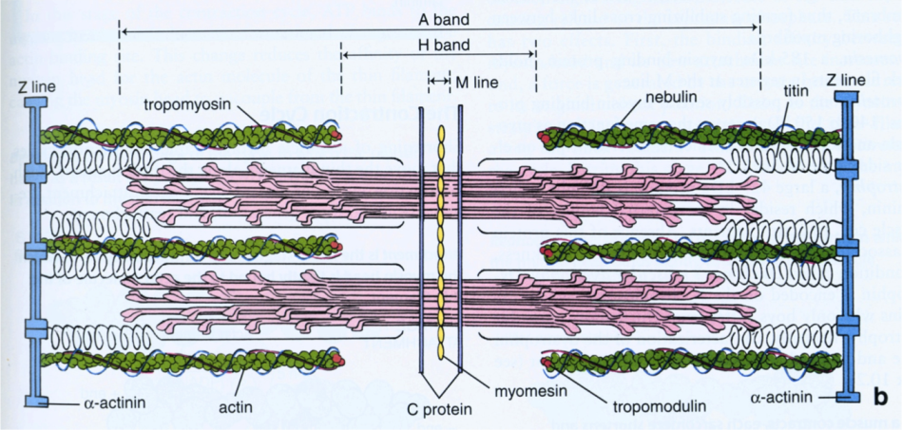
http://www.qstorm.org/2013/09/23/brainerd-lab-phalloidinalpha-actinin-double-stain-troubleshooting-tmodcommercial-qdots/

Slide 41
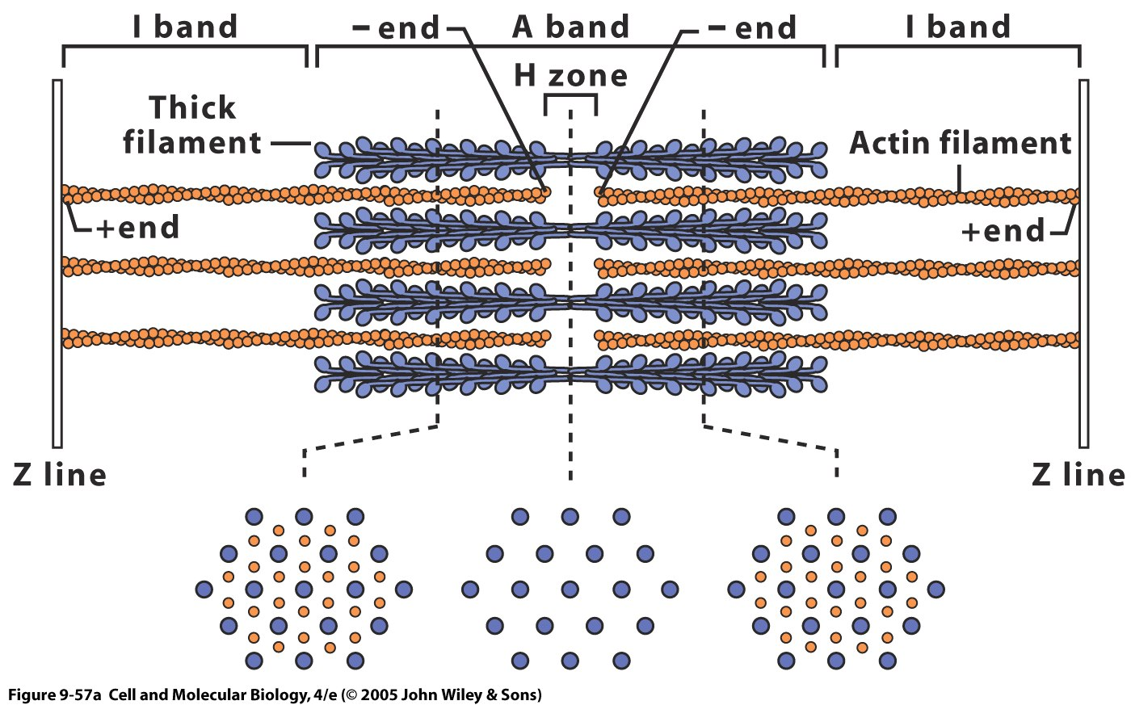
Myosin II heads in muscles are known as cross-bridges
(Thin)
In cross-section, blue is myosin (thick filament) and orange is actin (thin filament)

Slide 42
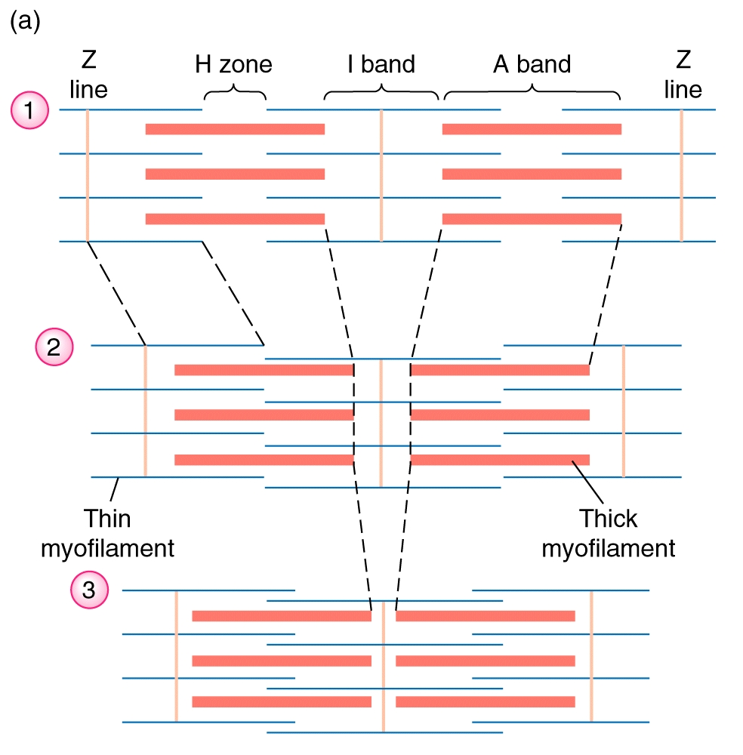
Sliding Filament Hypothesis for Skeletal Muscle Contraction
● during contraction thin and thick
filaments interact
● cross-bridges bind actin
● the thin filament is pulled along the
thick filament toward the center of
the sarcomere
● the bond is broken between the
filaments and cross-bridge binds
another site on actin
● the thin and thick filaments don’t
change length
● degree of overlap between thin and
thick filaments change

Slide 43
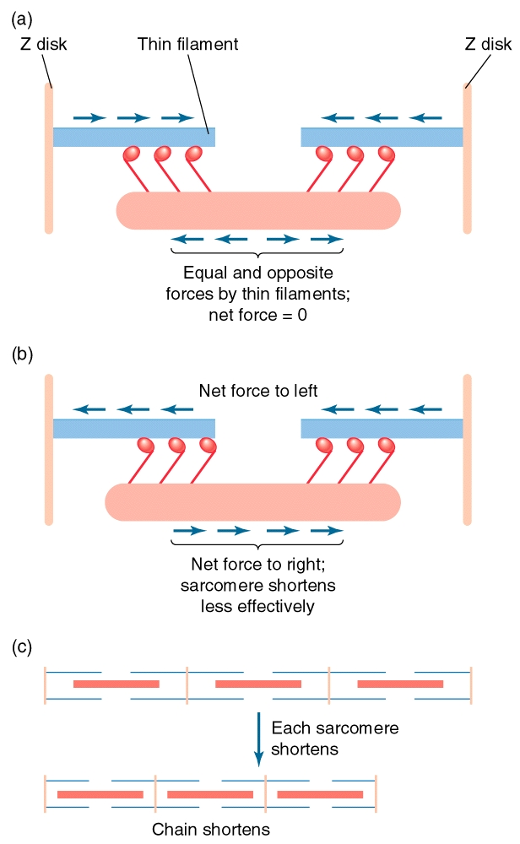
Unique arrangement of myosin molecules within the thick
filament allows sarcomere to shorten

Slide 44
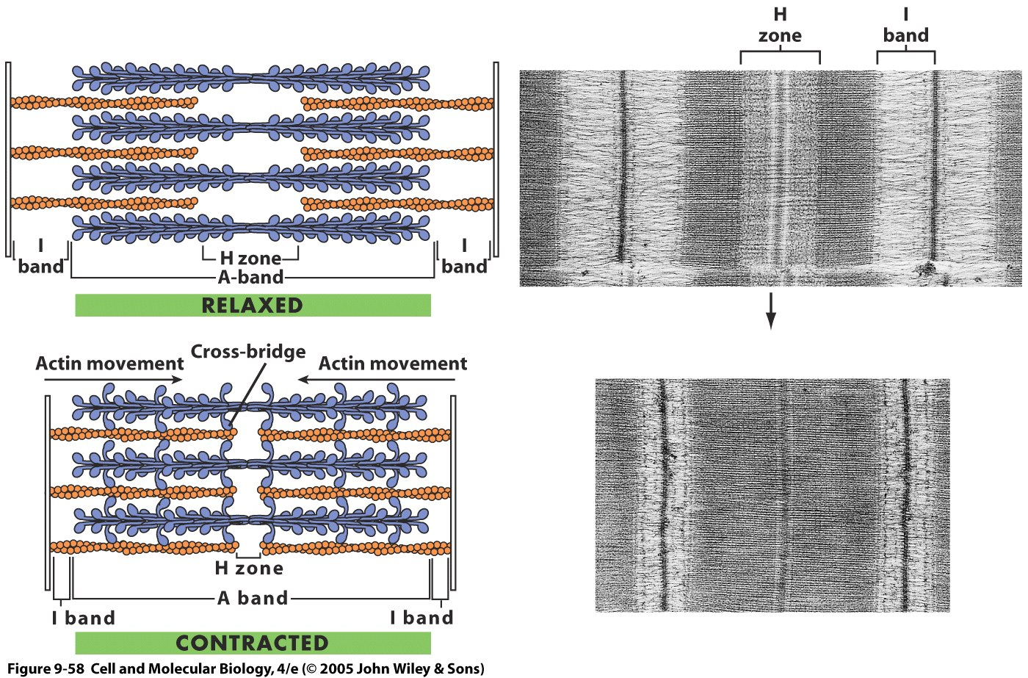

Slide 45
iClicker Question
When muscles contract, what part of the sarcomere shortens?
A band
H zone
I band
Both the A band and I band
Both the H zone and the I band

Slide 46
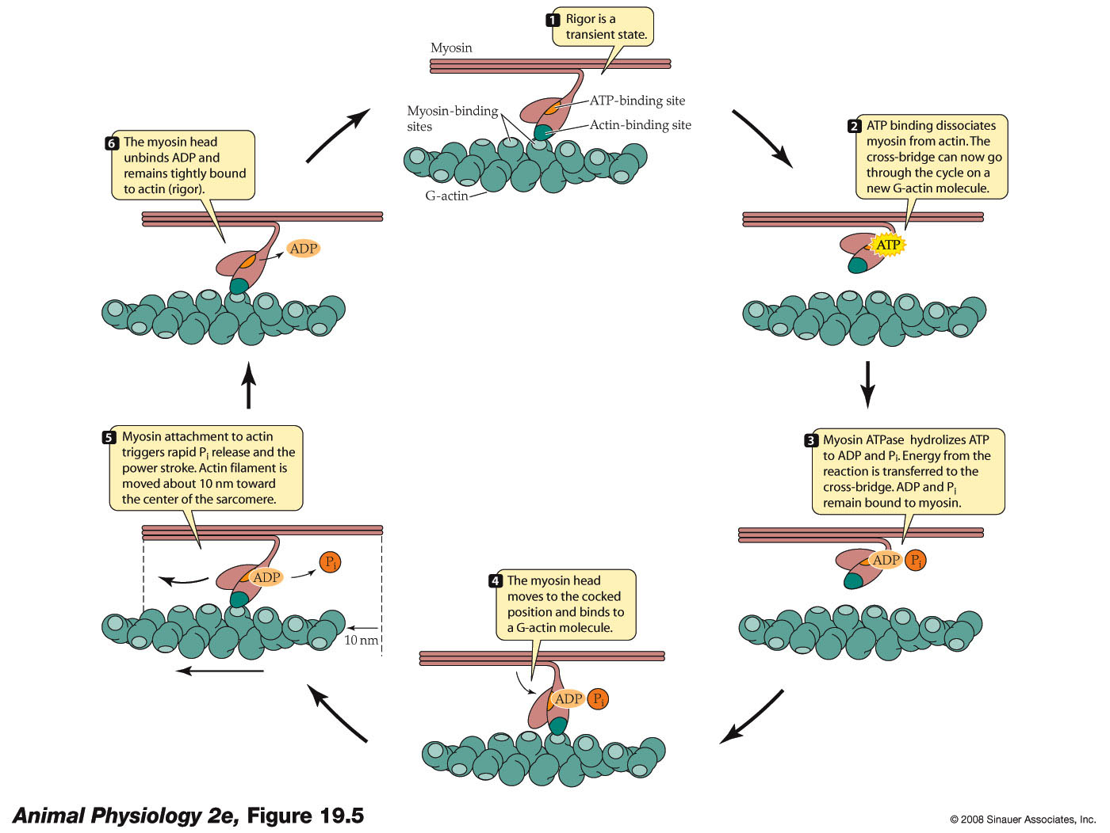
The cross-bridge cycle -- [Ca⁺⁺]_{i} high
Power stroke
Notes:
46
anphys2e-fig-19-05-0.jpg
Ca2+ bind to troponin, move tropomyosin, expose myosin binding sites on the actin molecules.

Slide 47
The power stroke results in sliding of actin
past myosin
https://www.youtube.com/watch?v=gJ309LfHQ3M
https://www.youtube.com/watch?v=Ki6WjplSUcE
Cross Bridge Cycle
Step 1: Cross Bridge Formation
Step 2: The Power Stroke
Step 3: Cross Bridge Detachment
Step 4: Reactivation of the Myosin Head

Slide 48
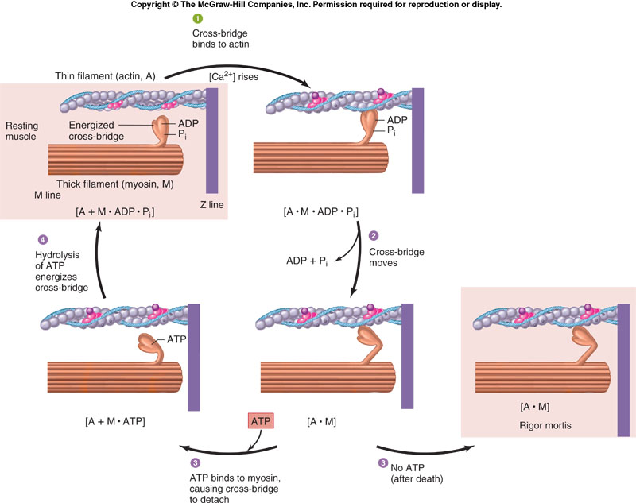
The cross-bridge cycle
Note: Pi release causes movement
From: Vander’s Human Physiology
Notes:
09.08.jpg

Slide 49
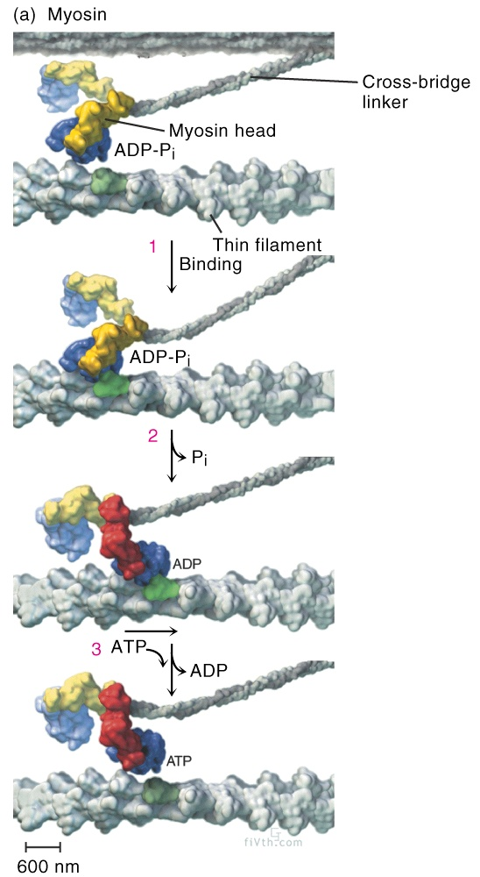
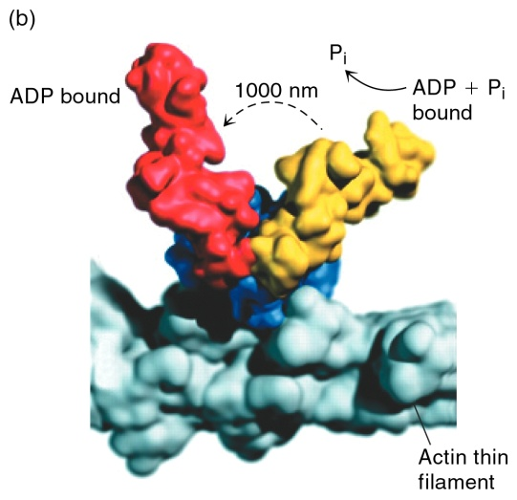
The hydrolysis of ATP and the release of P_{i} change
the conformation of the cross-bridge
● ATP hydrolysis energizes cross-bridge
● in ‘cocked’ position
● Release of P_{i} leads to release of energy
● head rotates relative to linker
● results in power stroke
● thin filament pulled
past thick
● Binding of ATP to cross-bridge leads
to detachment of thin and thick filaments
(neck)
ATP
hydrolysis
Notes:
49
www.youtube.com/watch?v=686qX5yzksU

Slide 50
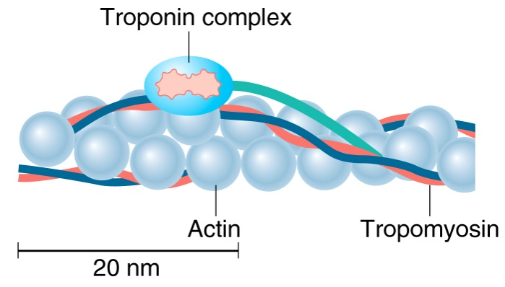
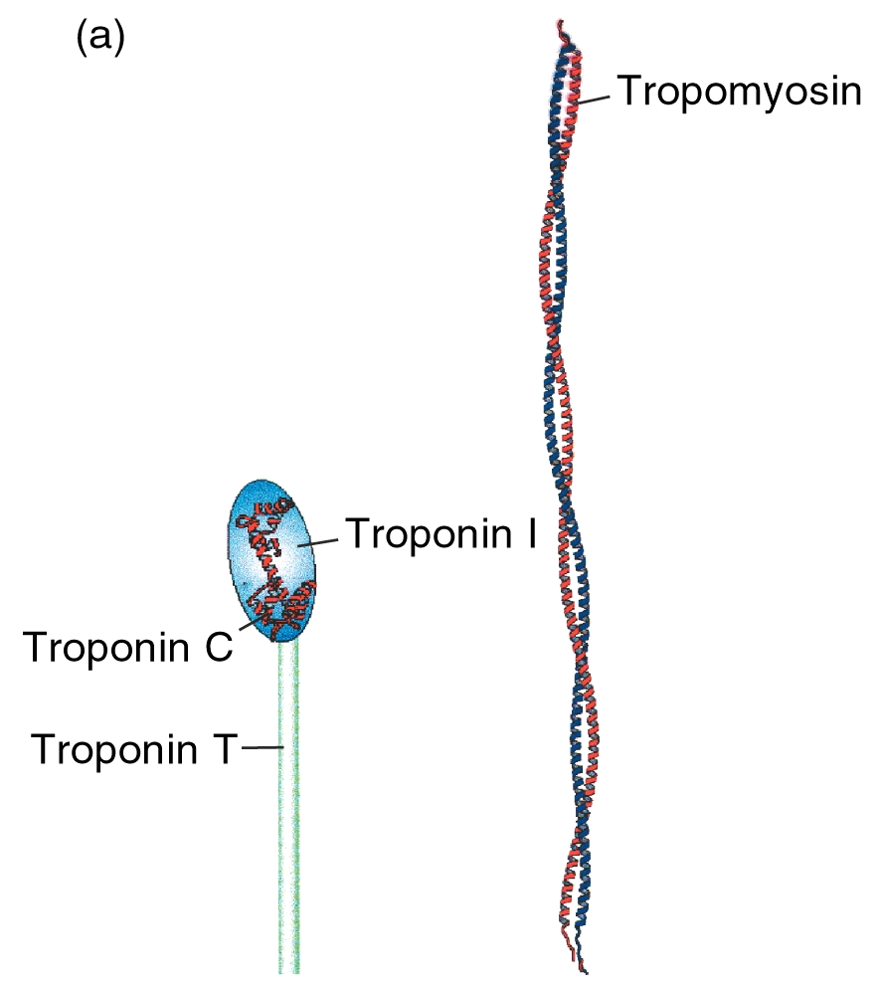
Tropomyosin and the troponin complex associate with
the actin thin filament
Tropomyosin
● Filamentous protein that winds around
actin filaments
● Blocks the myosin-binding site on actin in
resting muscles
Troponin complex
Troponin C – binds Ca⁺⁺
Troponin T – binds tropomyosin
Troponin I – binds both tropomyosin and
troponin C
● Troponin complex regulates tropomyosin
position on actin
Notes:
http://www.dnatube.com/video/1306/Role-of-myosin-crossbridge-in-the-contraction-of-muscle

Slide 51
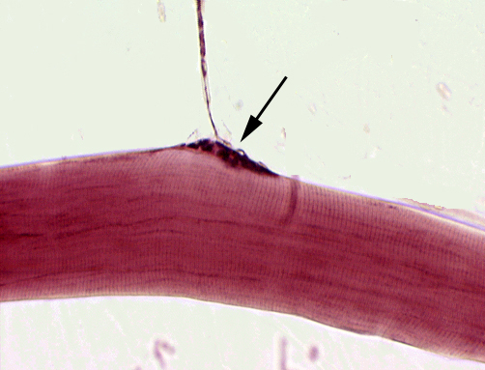
Excitation-contraction coupling
– Linking muscle APs to force generation -
Nerve terminal
Skeletal muscle fiber
education.vetmed.vt.edu/.../Labs/Lab10/lab10.htm

Slide 52
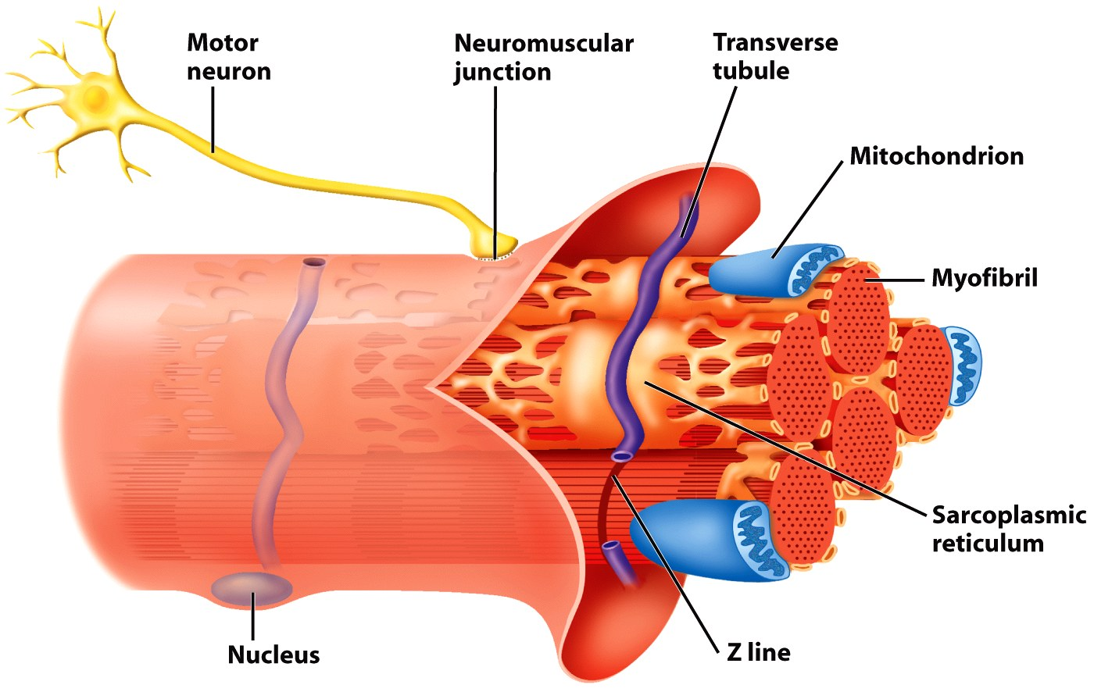
Muscles are excited by excitation-contraction coupling
T-tubule
Action potentials from the motor neuron excite the cell membrane and T-tubule network, inducing Ca++ release from the sarcoplasmic reticulum
https://www.youtube.com/watch?v=vDuqeCf09H4
Notes:
Heart excitation-contraction coupling: https://www.youtube.com/watch?v=vDuqeCf09H4

Slide 53
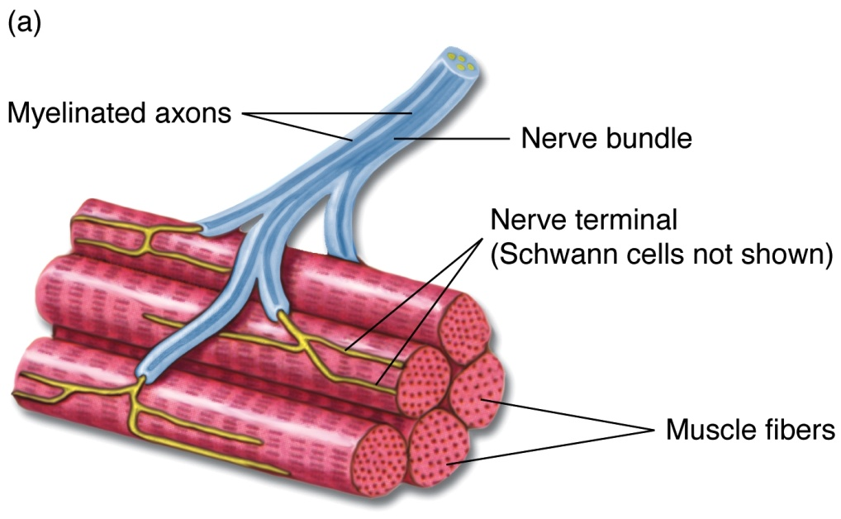
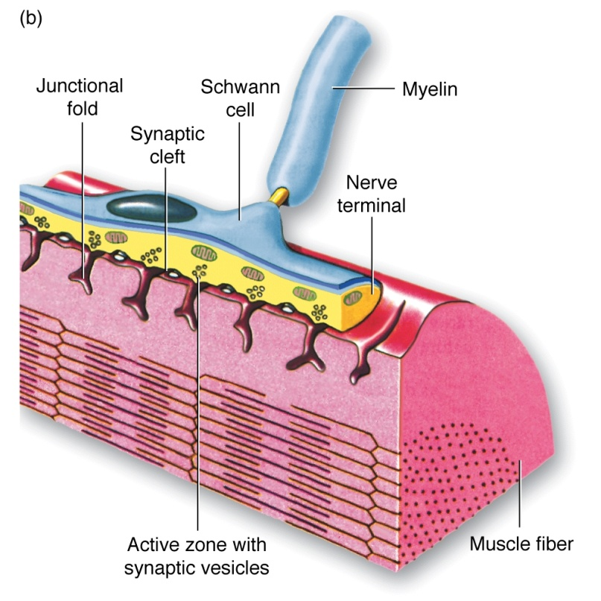
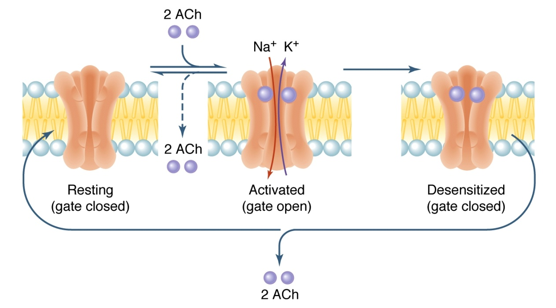
Activation of vertebrate neuromuscular junctions leads to
APs in muscle fibers
From: Eckert Animal Physiology
Notes:
voltage gated sodium and potassium channels

Slide 54
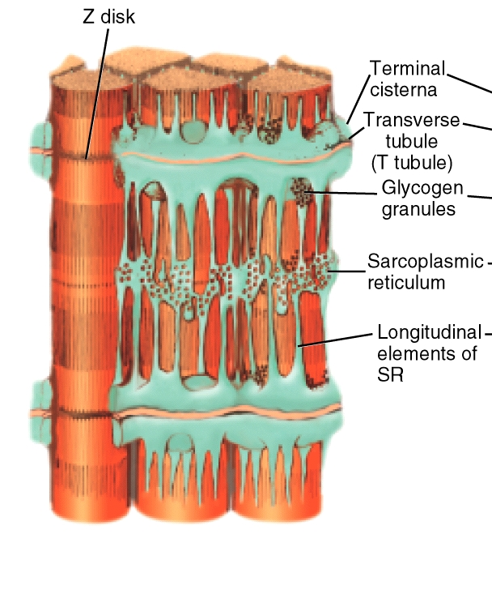
The SR (saroplasmic reticulum) is the source of calcium that initiates the
cross-bridge cycle
The SR is the ER for muscles
● Ca⁺⁺ is actively pumped from the cytosol into SR via a Ca⁺⁺ -ATPase, also called SERCA (Sarco/Endoplasmic Reticulum Ca⁺⁺-ATPase) pump
● Ca++ binds calsequestrin protein in SR
- keeps free Ca++ in SR low so
pump has lower gradient to work
against

Slide 55

Role of ATP in muscle contraction
Energize cross-bridge (hydrolysis)
Sequestration of Ca⁺⁺ by SERCA (hydrolysis)
Detachment of thin and thick filaments (binding)
During physical activity ATP consumption can increase by
20 to several 100 fold, but muscle ATP levels don’t change!
Notes:
09.08.jpg

Slide 56
iClicker Question
Which of the below structure is not found in Myosin motor?
A) ATP-binding site
B) Light-chain
C) Ca++-binding site
D) Actin-binding site

Slide 57
iClicker Question
Which of the following description is not the function of actin filaments?
Determining shape of the cell
Provide high tensile strength to the cell
Forming cellular projections
Transportation of cytoplasmic vesicles and organelles
Prevent sarcomere from being pulled apart during muscle stretching

